Slide 1
“When the Code becomes a Crime Scene”
Towards Dark Web Threat Intelligence with
Software Quality Metrics
Presented by: Chen Tse, Chen & Chieh Huang

Slide 2

Introduction to the Dark Web
What is the dark web?
The dark web is a hidden portion of the internet not indexed by standard search engines and accessible only through special software that ensures anonymity and privacy.
Facilitating a range of illegal activities, including drug trafficking, weapons sales, and other forms of cybercrime.

Slide 3
The Problem Addressed
Existing Challenges: Web monitoring heavily relies on Natural Language Processing (NLP), which is limited by its dependence on textual data that can vary widely.
Generalization Issues: Fail to effectively monitor content in various languages and dialects, reducing their effectiveness across different regional specifics.

Slide 4
Motivation for the Study
Law Enforcement Needs: Need for better tools to monitor and combat dark web activities.
Limitations of Text-Based Analysis: Reliance on NLP techniques can miss non-textual cues and context, limiting the ability to detect more subtle forms of illegal activities.
Goal: Aims to develop a more robust, language-independent method using software metrics and web appearance parameters.

Slide 5
Proposed Solution
Innovative Approach: Use of software quality metrics and website appearance parameters as new indicators to detect illegal activities on the dark web.
Tools Used: Utilize SonarQube for collecting over 40 different metrics from dark web pages, providing a broader detection scope.

Slide 6
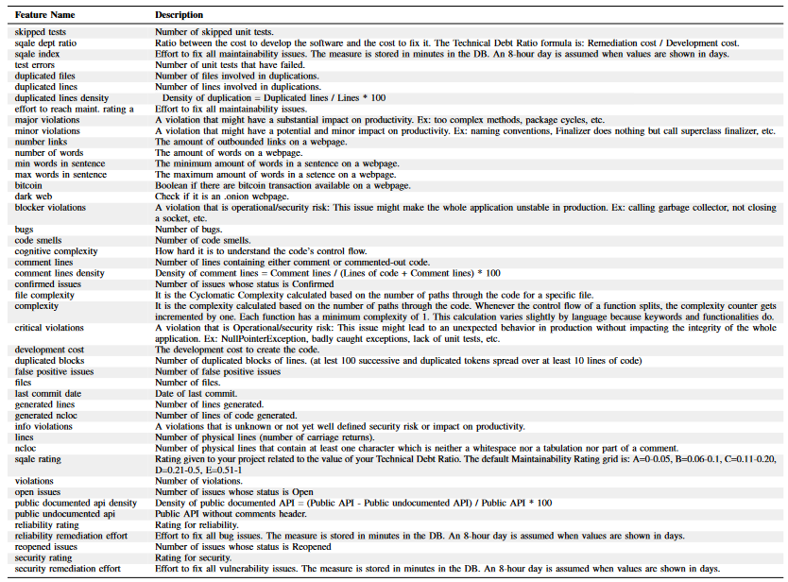
Proposed Solution

Slide 7
Methodology
Data Collection: Analysis of 10,367 dark web pages to collect data on various software and site characteristics.
Metrics Used: Key metrics include code complexity, lines of code, documentation quality, and website layout features.
Machine Learning Models: Machine learning models to classify web pages based on the collected metrics, aiming to identify potential illegal activities.

Slide 8
Practical Significance
Advantages Over Traditional Methods:
Comprehensive Coverage: Emphasize that unlike text-based analysis, proposed method analyzes structural and technical aspects of websites, providing a more comprehensive coverage.
Language Independence: Making it universally applicable across different regions without the need for linguistic adaptation.
Scalability and Adaptability: Can be dynamically adapted and scaled, unlike NLP models that need extensive retraining to adapt to new languages or dialects.

Slide 9
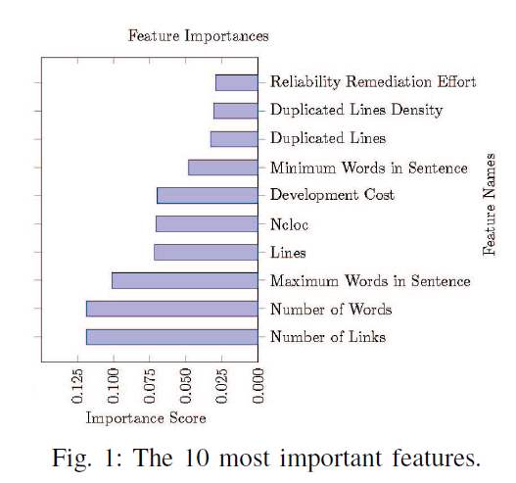
Result
Feature Importance:
Both the website appearance and software metrics appear in the list of the 10 most relevant features.
The figure also shows that dark web pages cannot be classified based on only 1 or 2 features, otherwise they would be possibly compromising classification accuracy.

Slide 10
Result
Model Comparison:
Random forest classifier has the best performance on both where the target variable consists of the 26 different illicit activities(66% accuracy), and the high granularity categorization(3 different illicit activities)(81% accuracy).

Slide 11
The research questions addressed
RQ1: To what extent can online illegal activities be classified based on source code metrics and website appearance parameters?
The analysis showed the important on both software code metrics and website appearance parameters are crucial for predicting a dark web page. These two features have predictive power and should be considered when classifying dark web pages.

Slide 12
The research questions addressed
RQ2: Which classifier outperform when classifying illicit online activities?
The Random Forest algorithm classifier outperforms the other classifiers in classifying suspicious, normal, and unknown webpage.

Slide 13
Novelty
This study provides a novel approach to classifying illicit activities of dark web pages using software code metrics and website appearance parameters, and plans to improve the dataset’s quality by crawling and labeling new pages and analyzing additional characteristics of the source code.

Slide 14
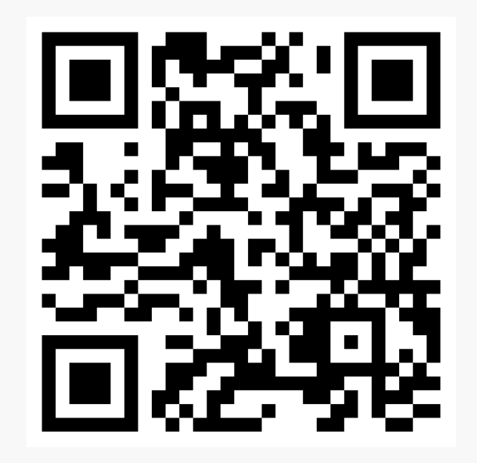
Future work
Illicit Darkweb Classification via Natural-language Processing: Classifying Illicit Content of Webpages based on Textual Information

Slide 15
Limitation and Discussion
Authentication issue: This kind of detection method cannot get through the website that provides an authentication service, as it can only scan the cover page information.
Privacy issue: The reason some people use the dark web is the privacy issue, especially in some countries that execute some speech limitation policies. This new technique may affect those people who want to get out of being control.
Updating issue: The ability to identify illegal activities with high accuracy it’s due to having a good dataset, so need to keep updating to keep high accuracy.
Contextual understanding issue: May not grasp the deeper contextual nuances of communication often used in illicit transactions.

